Slide 1

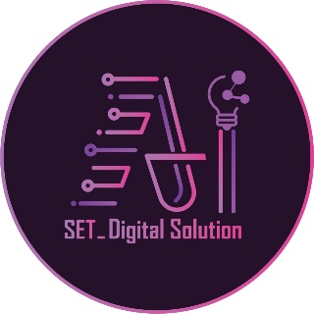

Inova-AI (AI-SET)
AI-SET Digital Solution & AI-SET Academic
Submitted by:
Dr. / Adel El-Sahfy [Chairman & Owner]
Dr. / Islam Abu-Seta [Chief Executive Officer (CEO) & Founder]
2024

Slide 2
Outline
Vision
Mission
Digital Solution
Our Services
Industry 4.0
Automation & System Integration
Enterprise Solutions
Custom Solutions
Custom as a Service
Remote Managed Services
High Performance Computing
Automotive Services
The control of autonomous electric vehicle by using deep learning models
Wireless Home Automation
Academic

Slide 3
Vision
Be a frontrunner technology partner for the automotive industry & IOT technologies within the EMEA region.

Slide 4
Mission
By harmonizing innovation, cutting-edge technology, and operational excellence, we navigate the path to sustainable growth, distinguishing ourselves as an employer of choice & trusted partner.

Slide 5

Digital Solution
Technology Provider
Research, Design and Development
Software and Hardware Development Services
System IntegratorService Partner
Certified Distributer and After Sales partner
IOT Products
Maintenance & Warranty
Automation & System Integration Services
Integration, Installation, Retrofitting and Training
Factories & Machines
System IntegratorService Partner

Slide 6
Our Services
Our Services help to bridge the gap between the technology providers, and the industrial applications in need to adopt the latest IoT innovations. We also support our technology partners and customers during the product development phases, by providing the needed experts levering the product cost and time to market.

Slide 7
Indusrty 4.0
Industry 4.0 is the future of industrial automation that integrates the comprehensive digitisation of machines and factories, in order to improve their productivity and management.

Slide 8
Automation & System Integration
System Integration, Control System Upgrade, retrofitting, Smart Factories and IoT Applications.

Slide 9
Enterprise Solutions
We help your business reach it’s organizational goals by identifying the obstacles and carefully designing digitized solutions to overcome even the most complex business problems.

Slide 10
Custom Solutions
We help you reach your business goals by identifying the hurdles and thoroughly design and deploy digital solutions, to overcome and facilitate even the most complex business problems. Our team of architects and developers ideate, analyze, design, and implement solutions that fit your business needs by adopting the best fit technology stacks and frame works.

Slide 11
Custom as a service
Our QA testing engineers have excellent analytical knowledge and skills, as well as extensive experience to analyze the features of the solution and the requirements of the customer. They develop the most appropriate testing strategy for each project using the best practices of functional, API, Performance and Acceptance testing. Our team of testing engineers performs various types of manual and automation testing to make sure your solution operates in a way that win your users’ satisfaction

Slide 12
Remote Managed Services
We use a structured process to build the right, long-term dedicated team for your project. Our high-performance frontend and full stack developers provide the expertise you need to deliver solutions using key cutting edge technologies. We provide our customers with the best of both – control &flexibility over their project development using simple three steps, Enlightening, Screening and Onboarding.

Slide 13
High performance computing
Leveraging a decade of experience in the HPC services industry our professional services team is able to provide various HPC services ranging from Cluster Implementation and sizing, application installation and monitoring to Code optimization and software consultancy.
HPC Systems
We build Super computers on premises and in the cloud using different open-source and commercial software tools (cluster manager installation and configuration, a variety of OS, network design verification and configuration, storage and Parallel file system configuration, schedular installation, configuration and customization, HPC cluster monitoring configuration and customization.We provide support on existing HPC clusters (fix user issues, report bugs, compile applications, expand cluster, upgrade versions, etc).

Slide 14
Advanced Computing and AI
We enable scientists to effectively use computing resources to achieve excellence in their respective fields, bridging the gap between HPC, software design, artificial intelligence and parallel programming. Our team is experienced in multiple computing fields like computer architecture, software design, parallel programming, optimization, distributed computing and deep learning, we offer cluster-based computing services, end-to-end solutions for scientific research, computational science and AI solutions in different domains.

Slide 15
Automotive Services
Our team has very strong experience developing safety-critical automotive systems to most of the car makers around the globe from the classical car makers where safety, security and certification represent the core principals to the disruptive ones where performance, technology and software-defined features are the main theme.
Our Automotive Engineering Services teams have been delivering world class development activities in several domains such as autonomous driving, electric powertrain, body & chassis and infotainment.

Slide 16
The control of autonomous electric vehicle by using deep learning models
The main aim of investigation of thesis is to investigate how to build system capable of staying in the middle of the lane during autonomous driving without slipping, as well as implementing a set of algorithms to demonstrate and evaluate this behavior with a down-sized prototype vehicle and using Lidar and Radar sensors for the interaction control of vehicle by using Deep learning models.

Slide 17
Wireless Home Automation
Home automation is the residential extension of building automation. It is automation of the home, housework or household activity. It can include centralized control of lighting, HVAC (heating, ventilation and air conditioning), appliances, security locks of gates, doors and other systems for improved convenience, comfort, energy efficiency and security.

Slide 18

Mechatronics
Academic
Mechanical
Electrical
Programming

Slide 19
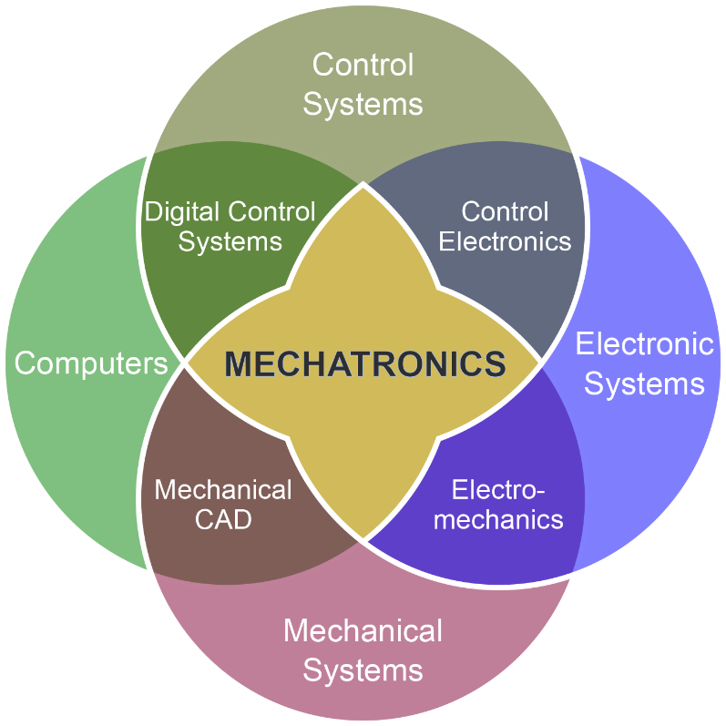
Mechatronics

Slide 20
Mechanical
Engineering Drawing (Class A and Class B)
Statics of Mechanics
Dynamics of Mechanics
Principles of Mechanical Design (Design A, B and C)
Stress Analysis
Design with Solid Work

Slide 21
Electrical
Electrical Circuits
Electronics
Devices
Electromagnetic Waves
Logic Circuits
Digital Circuits
PLC
Control Systems
Printed Circuit Board

Slide 22
Programming
Mathematics (A, B, C, D, E, F)
Statistics
C language
Arduino
Microcontroller
Rasberry pi
Matlab
Python
Artificial Intelligence (Machine Learning – Deep Learning)

Slide 23
Technical Writting
Office
High Thinking Level (Human Resources)
Ielts

Slide 24
Level 1
Engineering Drawing A1
Statics of Mechanics 1
Electrical Circuits
Logic Circuits
Mathematics A
C Language
Office (Word)
Level 1 of Ielts

Slide 25
Level 2
Engineering Drawing A2
Statics of Mechanics 2
Electronics
Mathematics B
Arduino
Office (Excel)
Level 2 of Ielts

Slide 26
Level 3
Engineering Drawing A3
Dynamics of Mechanics 1
Stress Analysis
Principles of Mechanical Design (Design A)
Solid 1
Devices of Electronics
Mathematics C
Microcontroller 1
Office (Power Point)
Level 3 of Ielts

Slide 27
Level 4
Engineering Drawing B1
Dynamics of Mechanics 2
Principles of Mechanical Design (Design B)
Solid 2
Electromagnetic Waves
Mathematics D
Microcontroller 2
HTL 1
Level 4 of Ielts

Slide 28
Level 5
Engineering Drawing B2
Principles of Mechanical Design (Design C)
Solid 3
Digital Circuits
Mathematics E
Microcontroller 3
Control A
HTL 2
Level 5 of Ielts

Slide 29
Level 6
Engineering Drawing B3
Solid 4
Mathematics F
Microcontroller 4
Control B
HTL 3
Level 6 of Ielts

Slide 30
Level 7
Solid 5
Printed Circuit Board 1
Statistics
Rasberry pi 1
PLC 1
PID Controller 1
HTL 4
Level 7 of Ielts

Slide 31
Level 8
Solid 6
Printed Circuit Board 2
Rasberry pi 2
PLC 2
PID Controller 2
Level 8 of Ielts

Slide 32
Level 9
Matlab
Projects of Mechatronics 1 (Autonomous Electric Vehicle)
Level 9 of Ielts

Slide 33
Level 10
Artificial Intelligence (Machine Learning – Deep Learning) 1
Projects of Mechatronics 2 (Robotic Arm)
Level 10 of Ielts

Slide 34
Level 11
Artificial Intelligence (Machine Learning – Deep Learning) 2
Projects of Mechatronics 3 (Drone)
Level 11 of Ielts

Slide 35
Level 12
Python
Projects of Mechatronics 4 (CNC Machine, 3D Printing Machine, …..)
Level 12 of Ielts

